Slide 1

<number>
Computer Vision Homework Assignment
TA: Tran, Van Luan (陳文倫)
Email: tranvanluan07118@gmail.com
Cellphone: 0909 623 737
Robot Vision Lab (Room 122)
Notes:
<number>

Slide 2
<number>
Homework Assignment
Homework 01 (2017/10/23), Deadline: 2017/11/06
Homework 02 (2017/11/20), Deadline: 2017/12/04
Homework 03 (2017/12/18), Deadline: 2017/01/01
Notes:
1.
<number>

Slide 3
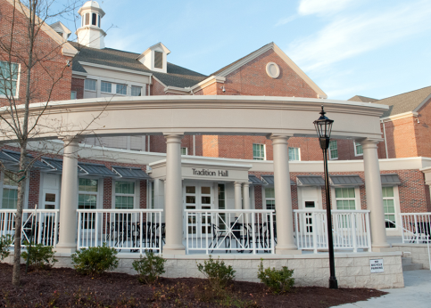
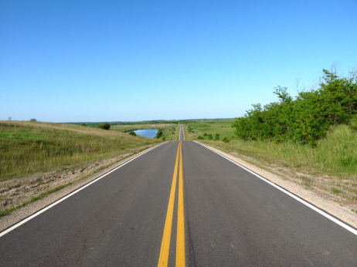
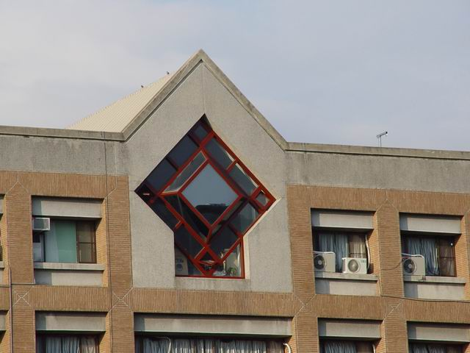
<number>
HW03
The purpose of this homework is to get familiar with Hough transform for line detection.
The require of homework:
Input( 3 test images )
Testing images

Slide 4
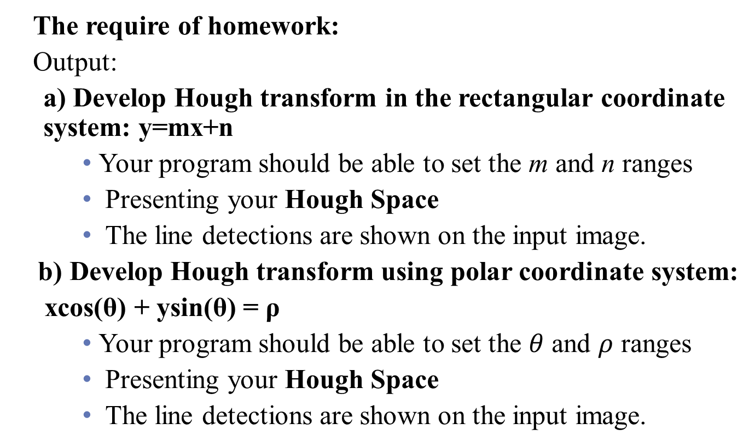
<number>
HW03

Slide 5
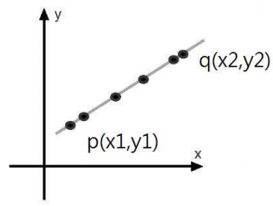
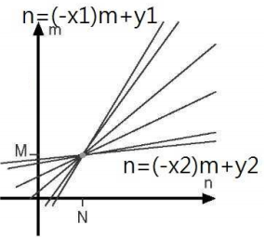
<number>
HW3
Rectangular coordinate system (y=mx+n)

Slide 6
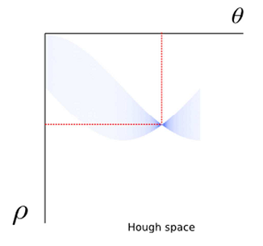
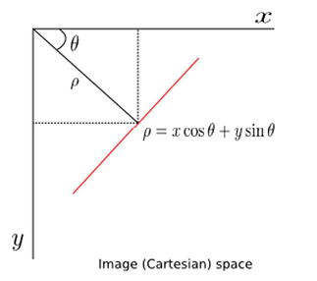
<number>
HW3
Polar coordinate system: xcos(θ) + ysin(θ) = ρ

Slide 7

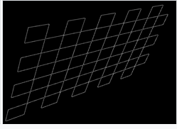
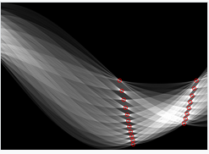
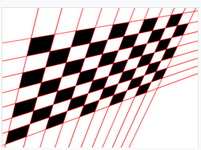
<number>
Example: line detection
Input image
Edge detection
Hough Transform Space
Output image

Slide 8
<number>
HW03
Note 01: Let apply an appropriate threshold or parameter you think it good for you results and explain it in your report.
Note 02: You cannot use the function to do the main part of homework from OpenCV Library.
Note 03: You can use the function in OpenCV with Edge Detection for HW3 (If you can not have a good results in HW02)

Slide 9
<number>
HW03
Grade
Program (80%)
Report : 20%
Describe the main part of your method
Result images
Compare and evaluate your results between rectangular coordinate and polar coordinate method.

Slide 10
<number>
Require for program
The rules is same as Homework 01.
Write your report by English.
You just create an empty project and write your homework on the one program
Use a C/C++ class, a subprogram,… .

Slide 11
<number>
HW03
Please compress your files (program and report)
StudentID_hw1( for example: 604415001_hw2.rar)
Please upload to E-course.
Deadline: 2018/01/01
For each hour late, 10% of the total possible points will be deducted.

Slide 12
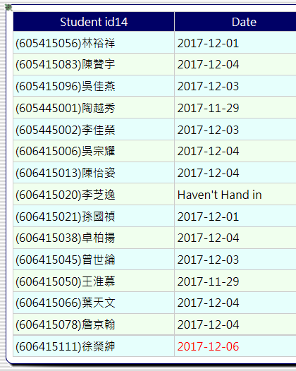
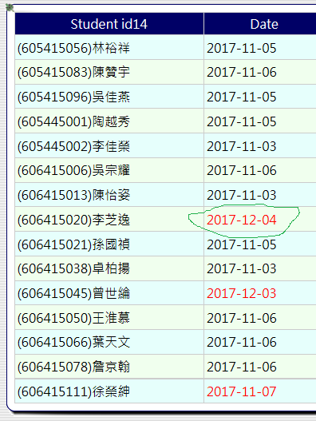
<number>
Uploading wrong place
Hw2 -> Hw1

Slide 13
Thanks for your attention
Notes:
<number>

